Slide 1
What are Frameworks?
Frameworks are libraries that provide a foundation for developing applications by offering a set of tools, patterns, and conventions. They help developers write clean, maintainable code and provide solutions to common development challenges.

Slide 2
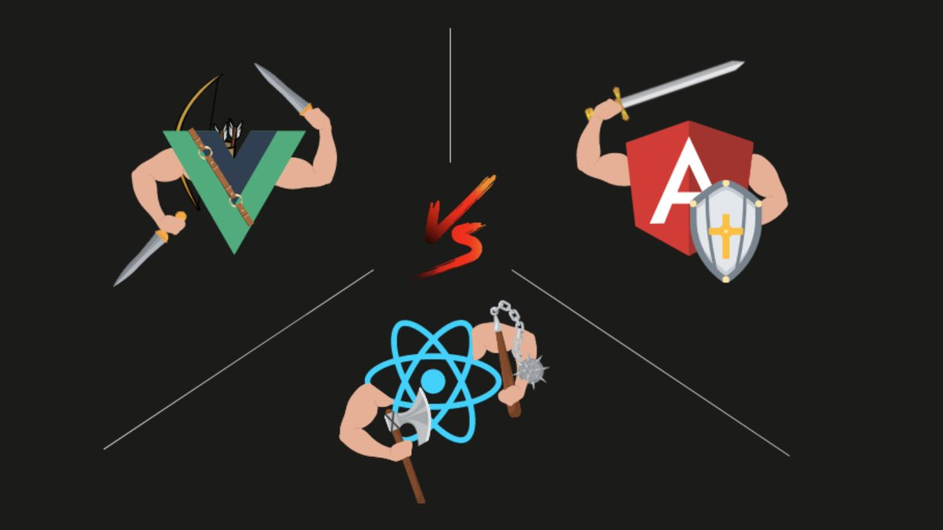
Introduction to Frontend Frameworks
Frontend frameworks are collections of pre-written code and tools that provide a structured approach to building web applications. They streamline the development process by offering reusable components and functionality.

Slide 3


Slide 4


Slide 5
Why Use a Framework?
Exploring the advantages of using a framework: Frameworks offer several benefits over vanilla JavaScript, including increased productivity, code organization, and faster development. They provide efficient ways to handle state management, data binding, and UI rendering.

Slide 6
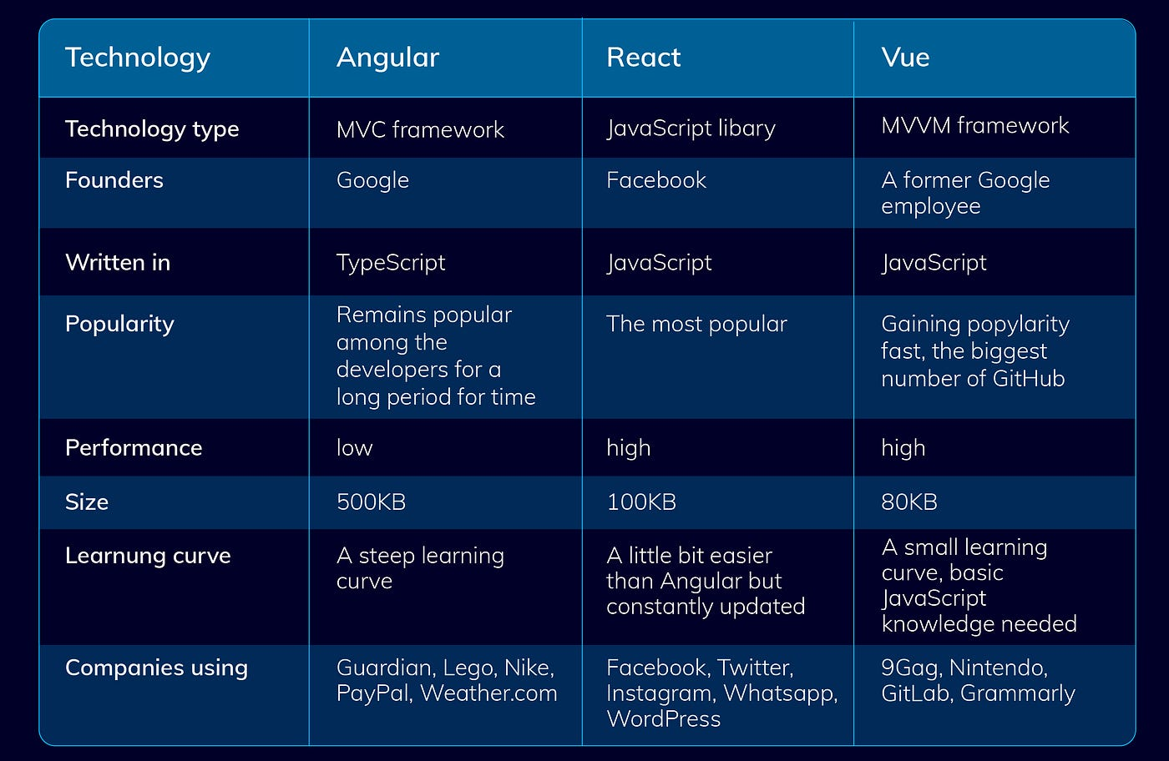

Slide 7

Introduction to React
React is a JavaScript library for building user interfaces. It follows a component-based architecture, where UIs are divided into reusable and independent components, allowing for better code organization and reusability.

Slide 8
Key Features of React
Overview of React's key features: React incorporates the Virtual DOM, a lightweight copy of the actual DOM that allows efficient updates and rendering. React also utilizes a declarative syntax, enabling developers to describe how the UI should look based on the state of the application.

Slide 9
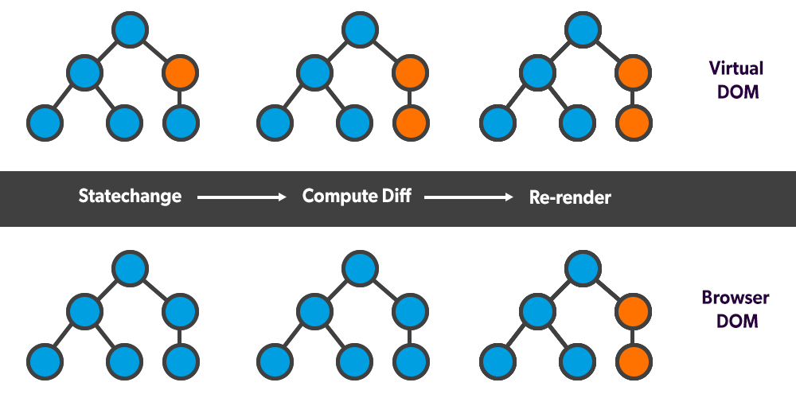
Virtual DOM
The Virtual DOM is a representation of the actual DOM in memory. React uses it to compare and update the minimal number of DOM elements required, resulting in faster rendering and improved performance compared to traditional DOM manipulation.

Slide 10
Components in React
Components are independent and reusable building blocks in React. They encapsulate both the UI and the behavior, making it easier to maintain and reuse code across different parts of an application.

Slide 11
React State and Props
Explanation of state and props in React: State represents the internal data of a component and can be modified within the component itself. Props, short for properties, are passed from a parent component to its child components and are used to provide data or configuration.

Slide 12
JSX Syntax
Overview of JSX syntax: JSX is a syntax extension for JavaScript used in React. It allows developers to write HTML-like syntax within JavaScript, making it easier to visualize and understand the structure of the UI.

Slide 13
React Lifecycle Methods
React components go through different stages, such as mounting, updating, and unmounting. React provides lifecycle methods that allow developers to execute code at specific stages, such as initializing data, performing side effects, or cleaning up resources.

Slide 14
Handling Events in React
Introduction to event handling in React: React has a synthetic event system that provides a consistent interface for handling events across different browsers. Developers can attach event handlers to React components and perform actions based on user interactions.

Slide 15
React Hooks
React Hooks are functions that allow functional components to use state and other React features. Hooks, such as useState and useEffect, provide a more concise and intuitive way to manage component state and handle side effects.

Slide 16
React Router
React Router is a library that enables routing in React applications. It provides a declarative way to define routes and handles navigation, allowing developers to create single-page applications with multiple views.

Slide 17
React and Redux
Introduction to Redux: Redux is a state management library commonly used with React. It follows a unidirectional data flow pattern and helps manage application state, actions, and reducers in a predictable manner.

Slide 18
React Testing
Discussion of testing techniques and tools for React applications: React provides various testing libraries and tools, such as Jest and React Testing Library, which enable developers to write unit tests, integration tests, and UI component tests. Testing ensures the reliability and correctness of React applications.

